Slide 1
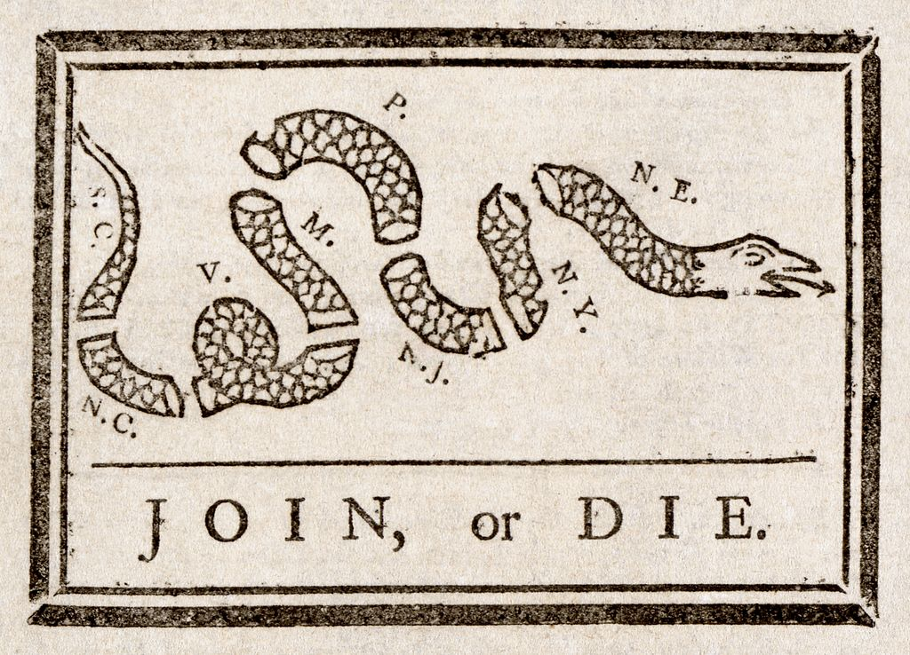
Colonial Nationalism
Pol Cartoon by Ben Franklin
Snake cut into 1/8ths
Each segment = reps 13 colonies or regions
NE = New England (reps 4 colonies)
DE (then part of PA) and GA = omitted
Represents "disunited state" of the colonies = colonial unity is importance
Used in Fr. & In. War
Need to join w/ G.B. to beat French/Indians
Used in Am Rev. War
Need to unite vs. G.B.
1754
1765

Slide 2
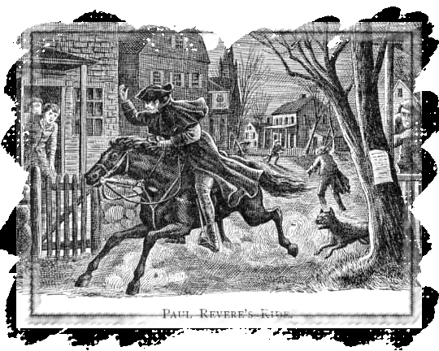
“The Shot Heard Round the World”
April 19, 1775
1st battle of Am. Rev.
Minutemen:
<Colonial Militia, ready in a minute>
Colonists: stockpiled weapons in Concord, MA
G.B. troops: In Lexington on the way to Concord
Who fired 1st shot?
Paul Revere (Member Sons of Liberty) warned colonists: “The British are coming!”
Notes:
Enough was enough, American colonists stockpiled weapons in Concord, Massachusetts, outside Boston. Then fighting began. The first battles occurred outside Boston, in Lexington and Concord. It is often called “The Shot Heard Around the World” as 13 colonies decided to challenge the mighty British Empire. Paul Revere, one of the Sons of Liberty, warned colonists, “The British are coming!”

Slide 3
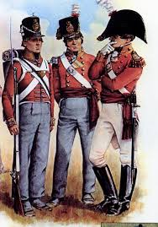
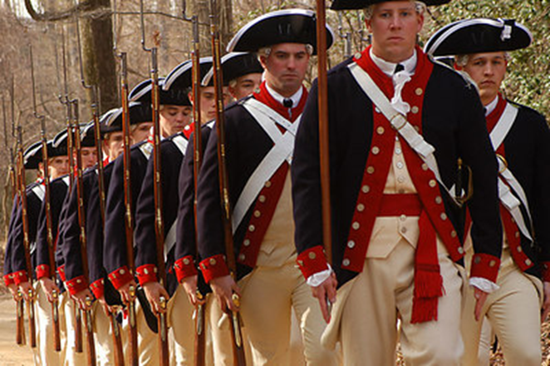
The Soldiers
British “Redcoats” (Lobsterbacks)
Continental Army (Colonial Army)
Lower classes
Professional soldiers
Trained by G. Washington
Lower classes, peasants, landless, worker class
Under paid & fed

Slide 4
Colonist Strengths
Focus = Fighting for independence
George Washington = inspirational leader
France = aide colonies w/ weapons, supplies and their navy

Slide 5
Colonist Weaknesses
Army:
Recently formed
Not trained
Limited:
Money
Weapons
Supplies

Slide 6
British Strengths
Army:
Experienced, professional army
Outnumber the Continental Army
Well supplied w/ equipment and weapons

Slide 7
British Weaknesses
Not fighting for a cause
Officers = poor leaders
Have to cross the Atlantic Ocean:
To send men and supplies
G.B. pple lacked support

Slide 8
War Strategies
American Colonies
Keep the Colonial Army together
About G.B. Army:
Stretch away from supply lines
Harass
Defeat in major battles
Get allies to help win!
Britain
Use loyalists’ support against the colonies
Regain colonies by region
About Colonial Army:
Destroy
Dictate fighting
Using European war tactics

Slide 9
Second Continental Congress
May 1775—In Philly
Outcome:
Decided to officially separate from G.B.
Will draft the reasons for separation
Thomas Jefferson→ to write document
Notes:
It was time to make the split from Great Britain official. After the initial battles of the war, the Second Continental Congress convened in May 1775 in Philadelphia to call for an official separation from Britain. A committee including Thomas Jefferson was selected to write a draft of all the reasons the colonists wanted complete separation from Britain. Jefferson was chosen by congressional vote to draft the document.

Slide 10
The Declaration of Independence
Written by Thomas Jefferson
“Birth Certificate of the United States”
Listed rights and grievances against King George III
4 parts:
Preamble
Declaration of rights
List of Grievances
Resolution
Notes:
A new country was about to be born. Thomas Jefferson was the unanimous choice to draft the document that would become the “Birth Certificate of the United States,” the Declaration of Independence. Benjamin Franklin and John Adams aided Jefferson with Declaration revisions. The document clearly listed colonists’ rights and their grievances against King George III.

Slide 11
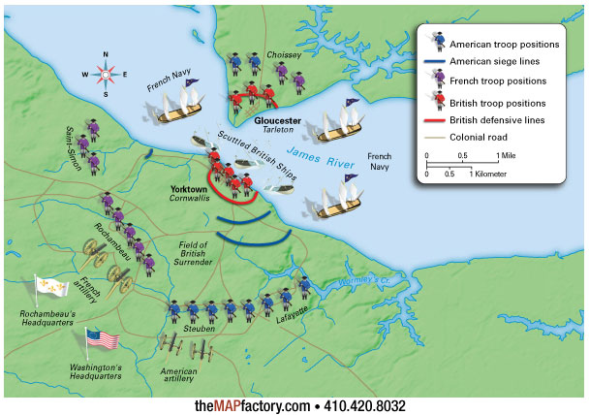
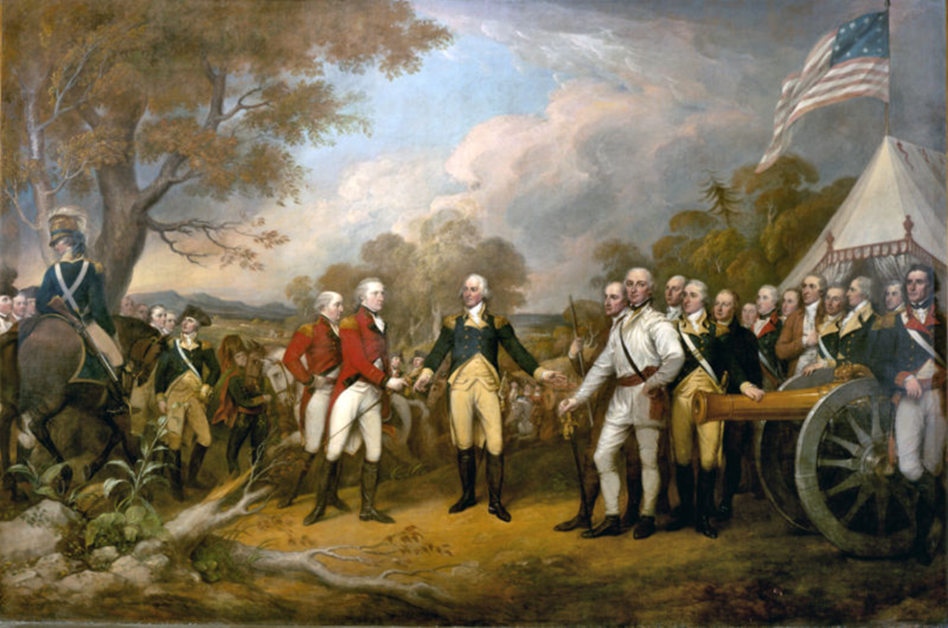
Battle of Yorktown
Final Battle: October 1781
French aided blockade
GB cornered
Gen. Cornwallis = Surrenders
Notes:
The end was in sight with the Battle of Yorktown. The Americans were aided by a French blockade making British escape impossible. British General Cornwallis faced American forces approximately twice his size and no where to go.

Slide 12
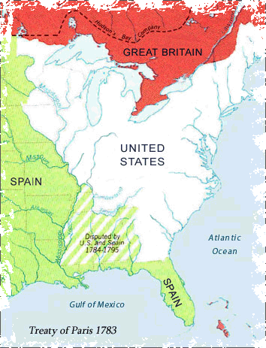
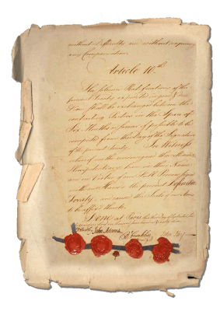
Officially ended Am. Rev. = Neg. by Benjamin Franklin
Recognizes Am. Independence
Geographic:
Set U.S./Canadian border
FL = back to Spain
Payments:
GB merchants = for lost items
Loyalists = for lost property
The Treaty of Paris—1783
Notes:
The official end to the war came two years after Yorktown at the Treaty of Paris. The British commander, Cornwallis, was so humiliated by the defeat that he refused to meet with Washington for the formal surrender and sent an aide instead. The treaty set many geographic borders including that of the United States and Canada. Canada went to the British, but later the French won part of the country. Florida was returned to Spain.

