Slide 1
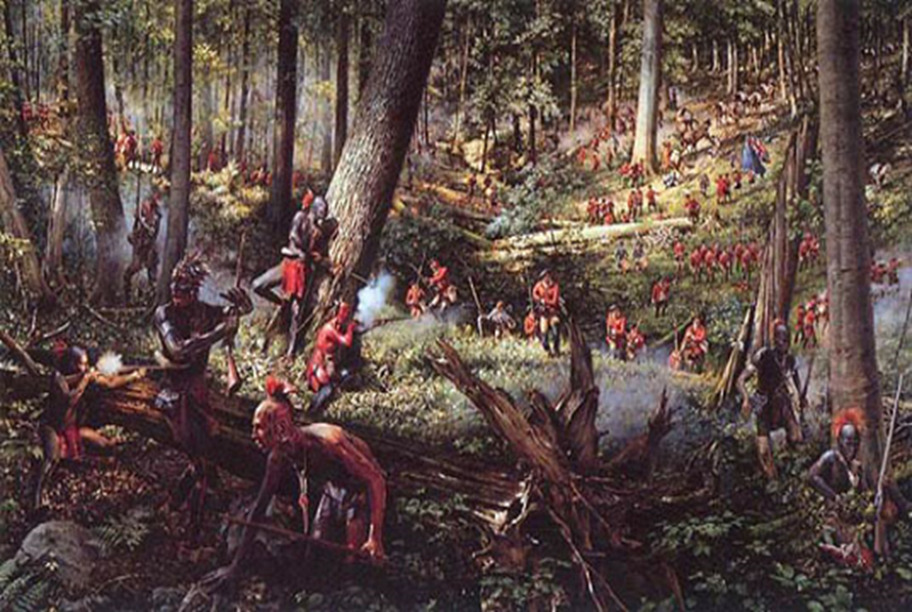
Causes of the American Revolution
1) French and Indian War:
→Increased tension btwn colonist and British
Colonist now united
British = indebt → need $ to sustain and protect colonies

Slide 2
Causes of the American Revolution
2) Unpopular Regulations on Colonists by British:
Proclamation Act of 1763
Attempt to stop colonial expansion at the Appalachian Mountains
Quartering Act of 1765
Required colonists to house and feed British soldiers
(Will eventually be addressed in 3rd Amend.)

Slide 3
Causes of the American Revolution
3)Taxation:
Why is Britain taxing the colonies???
British Parliament needed to raise $ (War debt, for protect of colonies)
It’s only fair = Pple in Britain paying higher taxes than colonist → colonist should pay more too

Slide 4
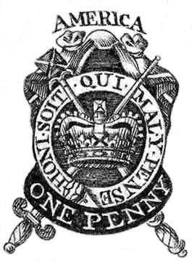
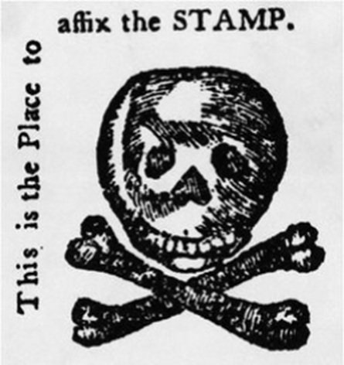
Causes of the American Revolution
Examples of Taxing:
Sugar Act: <Taxed imported molasses>
Already est., but British now enforcing collection
Created courts and customs officers to collect
Stamp Act: <Tax on printed goods>
Ex: Newspapers, books, land deeds
1st direct tax on colonies by British
Leads to confrontation in colonies

Slide 5
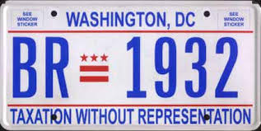
Causes of the American Revolution
Taxation Without Representation:
Does Parliament have right to directly tax the colonies?
Colonial Argument:
No colonies represented in Parliament = No vote on things = No right to tax colonies
British Argument:
Most British paid taxes and couldn’t vote
Major areas/towns in Britain don’t have reps in Parliament
The “Empire” needed money

Slide 6
Causes of the American Revolution
Resistance by Colonists = 3 forms
Why? = To get British to back down on policies/taxes
How???
1) Intellectual protests:
Writings, speeches, sermons by Colonist Leaders →persuade colonist to defy the new taxes
Enlightenment Ideas: (Locke)
Pple have natural rights = Life, liberty, and property
Gov’t = for good of pple → to protect pple’s rights

Slide 7
Causes of the American Revolution
Resistance by Colonists = 3 forms
How???
2) Violent Intimidation:
Patriots <Colonists who opposed British taxes>
Actively making voice heard
Sons of liberty <Assoc. of Patriots, formed to lead protrests against British actions in Colonies>
Leader = Samuel Adams
Attacked British supporters, ruined their property, assaulted tax collectors
Encouraged boycott of British goods

Slide 8
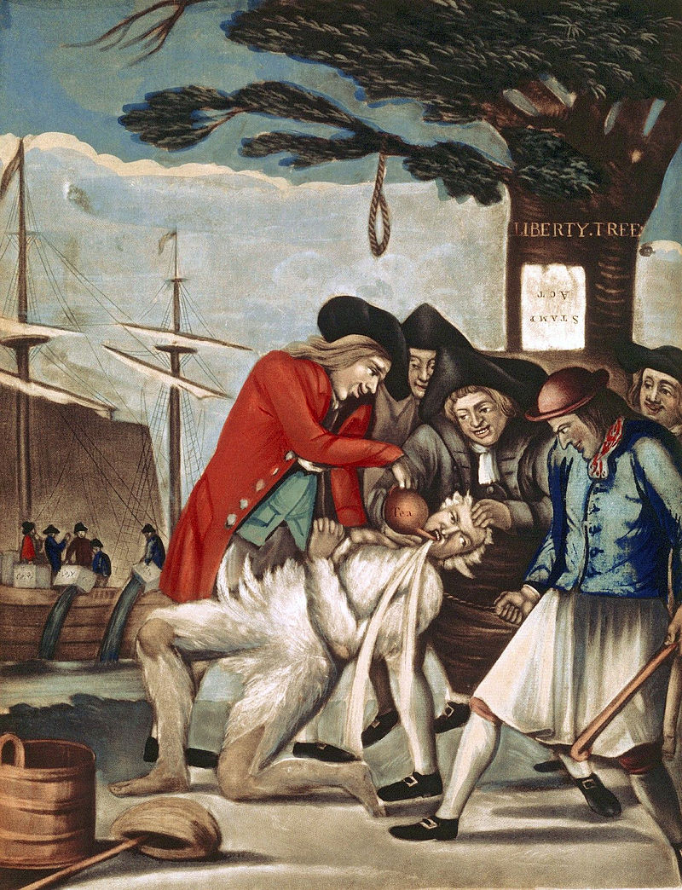
How would a painting like this affect colonists who were still loyal to the Crown?
Outraged/frightened them = They sided with the British
But the also feared the other colonist violent acts

Slide 9
Causes of the American Revolution
Resistance by Colonists = 3 forms
How???
3) Economic boycotts: (effort to avoid violence)
Colonist leaders urged pple to not purchase anything made in Britain
→ buy from local people/stores
Women = crucial to this success
Spinning/weaving
Making clothing
Daughters of Liberty <Name given to women who wove products to replace British goods>

Slide 10
Causes of the American Revolution
Resistance by Colonists = 3 forms
All factors/tactics combined worked = British repealed the Stamp Act (1766)
But… British still needed $$$
→ Passage of Townshend Acts (1767): <Put a tax on imports (items coming from Britain)>
Taxed everyday items (paper, tea, glass, etc)
→ Colonist begin revolting again (riots, protests, boycotts)
Boston especially bad → British send 4,000 troops over to patrol Boston

Slide 11
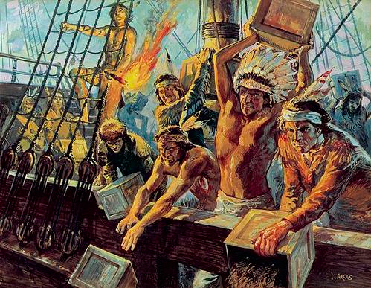
Causes of the American Revolution
The Boston Massacre (3/1770)
Colonist protest Townshend Acts →British soldiers kill 5 colonists in crowd
Result: British repeal all Townshend Act taxes, except for the tea tax
Encourages smuggling tea
Boycott of British tea = $ problems for British businesses
Boston Tea Party (12/1773)
200 colonists dressed as Native Americans →
Board British tea ships in harbor = Dumped tea Result: British send 2,500 soldiers to Boston
→ passage of the Coercive Acts

Slide 12
How can you tell that the author, Paul Revere, intended this to be propaganda?
Boston Massacre

Slide 13
Causes of the American Revolution
Coercive Acts of 1774 (colonist called The Intolerable Acts)
More power → royal authorities in colonies
Quebec Act <Extended Canadian southern border → colonies lost land>
Placed Boston under Marshall Law
Shut down Boston Harbor = until lost tea is paid for by colonists
→ 1st Continental Congress formed (1774)
Philadelphia
Reps from colonies meet → what to do?

Slide 14
Patrick Henry: “Give me Liberty or Give me Death!”
1st Continental Congress Meeting

Slide 15
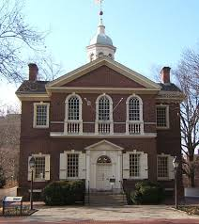
1st Continental Congress (1774)
12 of 13 Colonies sent delegates to Philly
GA = not originally but eventually sent reps
Purpose: To rep colonies and challenge British control
Key Participants: Samuel Adams, John Adams, John Jay, George Washington, Patrick Henry
Carpenter’s Hall

Slide 16
1st Continental Congress (1774)
Effects:
United colonies like never before
Created small provincial gov’ts/congresses → to help enforce boycotts, etc…
**These newly created gov’ts operated around the British crown = more friction btwn GB/colonists

Slide 19
Causes of the American Revolution
Lexington and Concord (April 19, 1775)
the “Shot heard round the world”
1st battle of Rev. War
Minutemen <colonial militia, ready in a minute?>
Massachusetts creates a provisional government under the control of John Hancock
Hancock calls for a colonial militia, the minutemen, to prepare for battle
70 minutemen fight 700 British regulars to mark the 1st battle of the Revolution
Militia eventually surround Boston and the British

Slide 20
